Slide 1

ENTER NAME OF THE PLAYER-1
ENTER NAME OF THE PLAYER-2
QUIT
CLICK TO PROCEED

Slide 2
ENTER NAME OF THE PLAYER-1
ENTER NAME OF THE PLAYER-2
QUIT
CLICK TO PROCEED

Slide 3
ENTER NAME OF THE PLAYER-1
ENTER NAME OF THE PLAYER-2
QUIT
CLICK TO PROCEED

Slide 4
PLAYER VS COMPUTER
ENTER YOUR NAME
QUIT
CLICK TO PROCEED

Slide 5
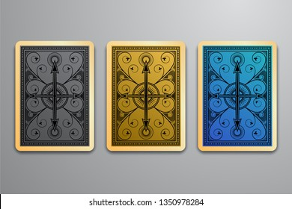
Please Wait While The Cards Are SHUFFLING

Slide 6
Please Wait While The Cards Are SHUFFLING

Slide 7
Please Wait While The Cards Are SHUFFLING

Slide 8
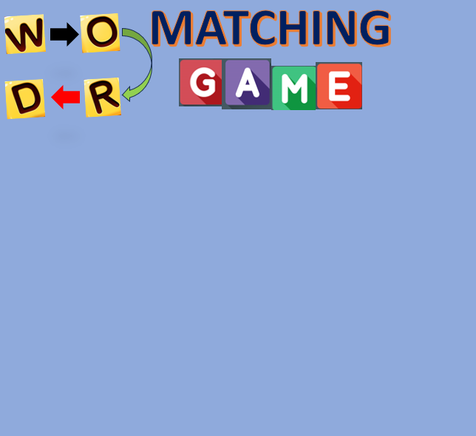







1. SUN
2. STAR
3. SAVIOUR
It’s not that easy at all !!
PLAY
Scores
ABOUT
?
RULES

Slide 9

It’s a game of LUCK !!
PLAY
Scores
ABOUT
?
RULES

Slide 10

It’s a game of LUCK !!
PLAY
Scores
ABOUT
?
RULES

Slide 11

It’s not that easy at all !!
PLAY
Scores
ABOUT
?
RULES

Slide 12
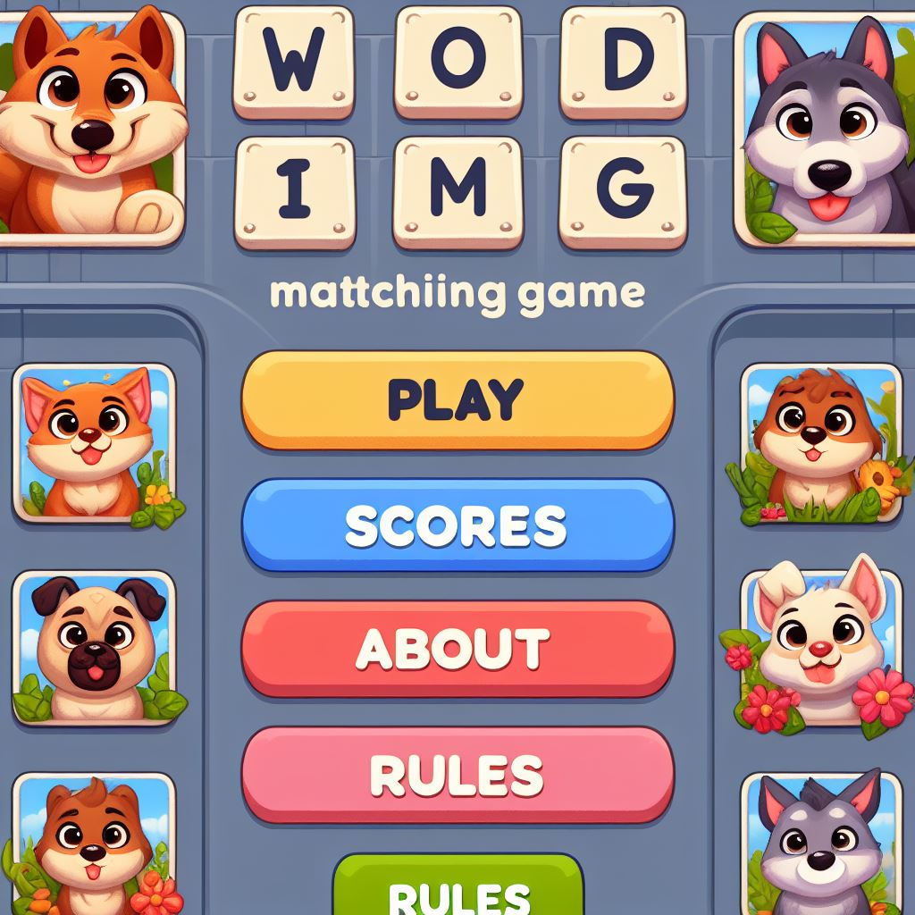
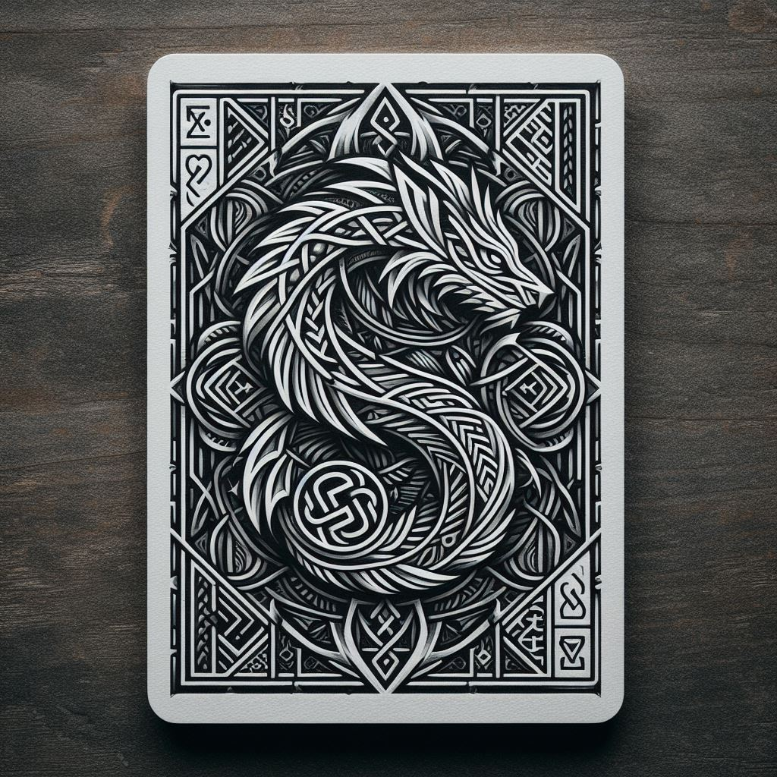

Slide 13
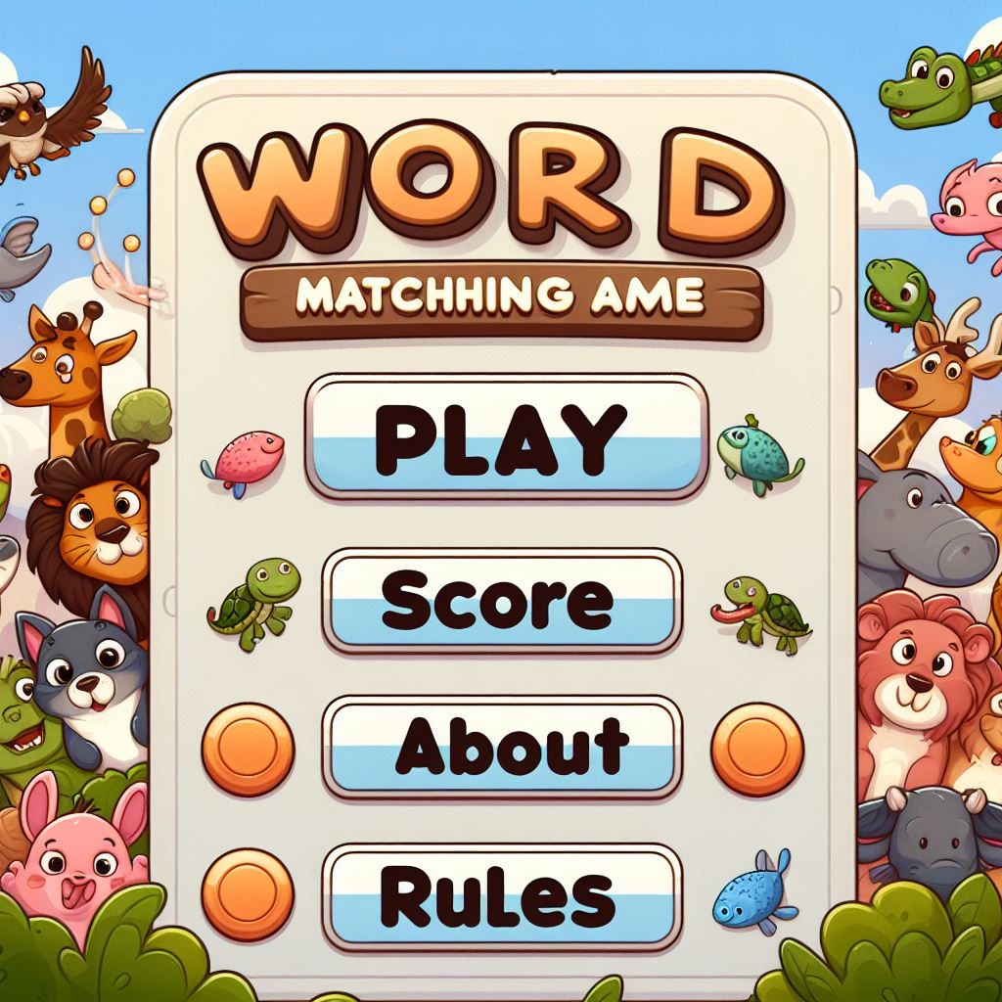

Slide 15


Slide 16
PLAY
Scores
ABOUT
?
RULES

Slide 17

shuffle

Slide 18


Slide 19


Slide 20
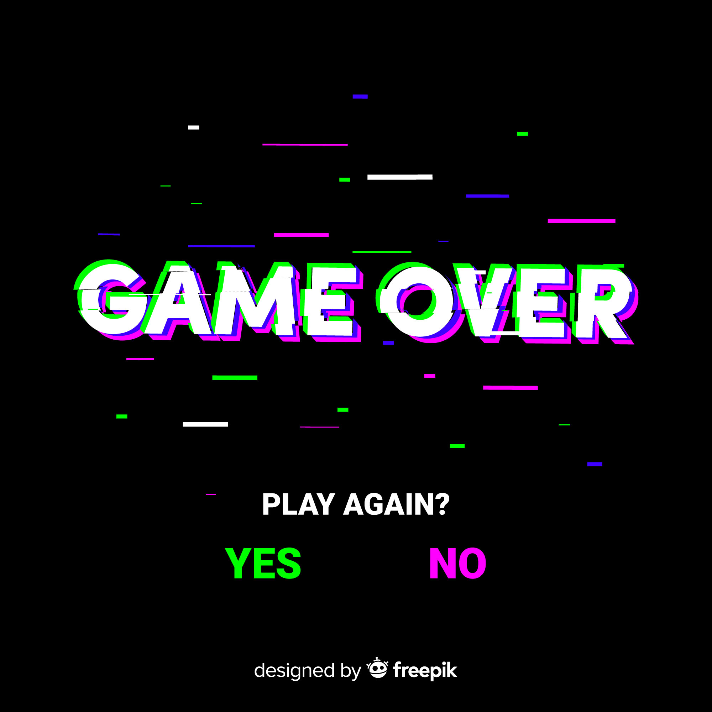

Slide 21
PLAYER VS COMPUTER

Slide 22















HIPPO
CAT
LION
HORSE
BEAR
COW
FISH
TIGER
RHINO
HEN
PANDA
DUCK
DOG
FROG
HARE

Slide 23
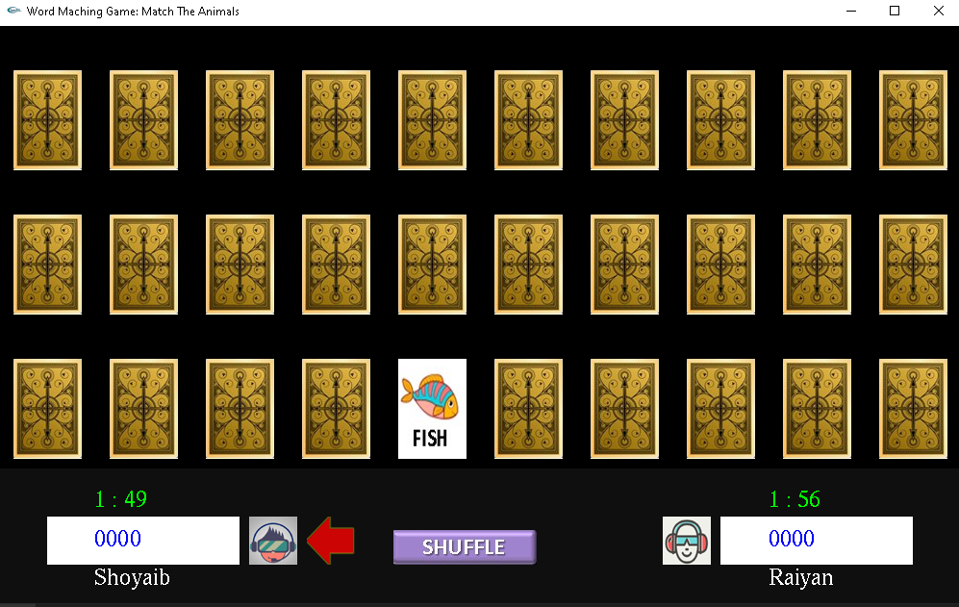
Click on another card to match the previous one
Click on a flipped card to see the animal
Timer
Score
Arrow Indicates Turns
Click It to Shuffle the remaining cards

Slide 24



2 cards match :: Player gets point and the cards disappear
2 cards mismatch :: Player doesn’t gets point and the cards flipped again

Slide 25
1. Player will get 100 points when a pair is matched.
2. When a wrong pair is chosen, the scoring rate gets decreased by 10 points
3. When a matched pair is chosen, the scoring rate gets increased by 10 points
4. If a draw is occurred then the victor will be decided on how quickly one has made one’s moves
Scoring System

Slide 26
SHUFFLE

Slide 27
DOG
CAT
COW
LION
TIGER
BEAR
HORSE
HARE
RHINO
HIPPO
PANDA
HEN
DUCK
FISH
FROG

Slide 29
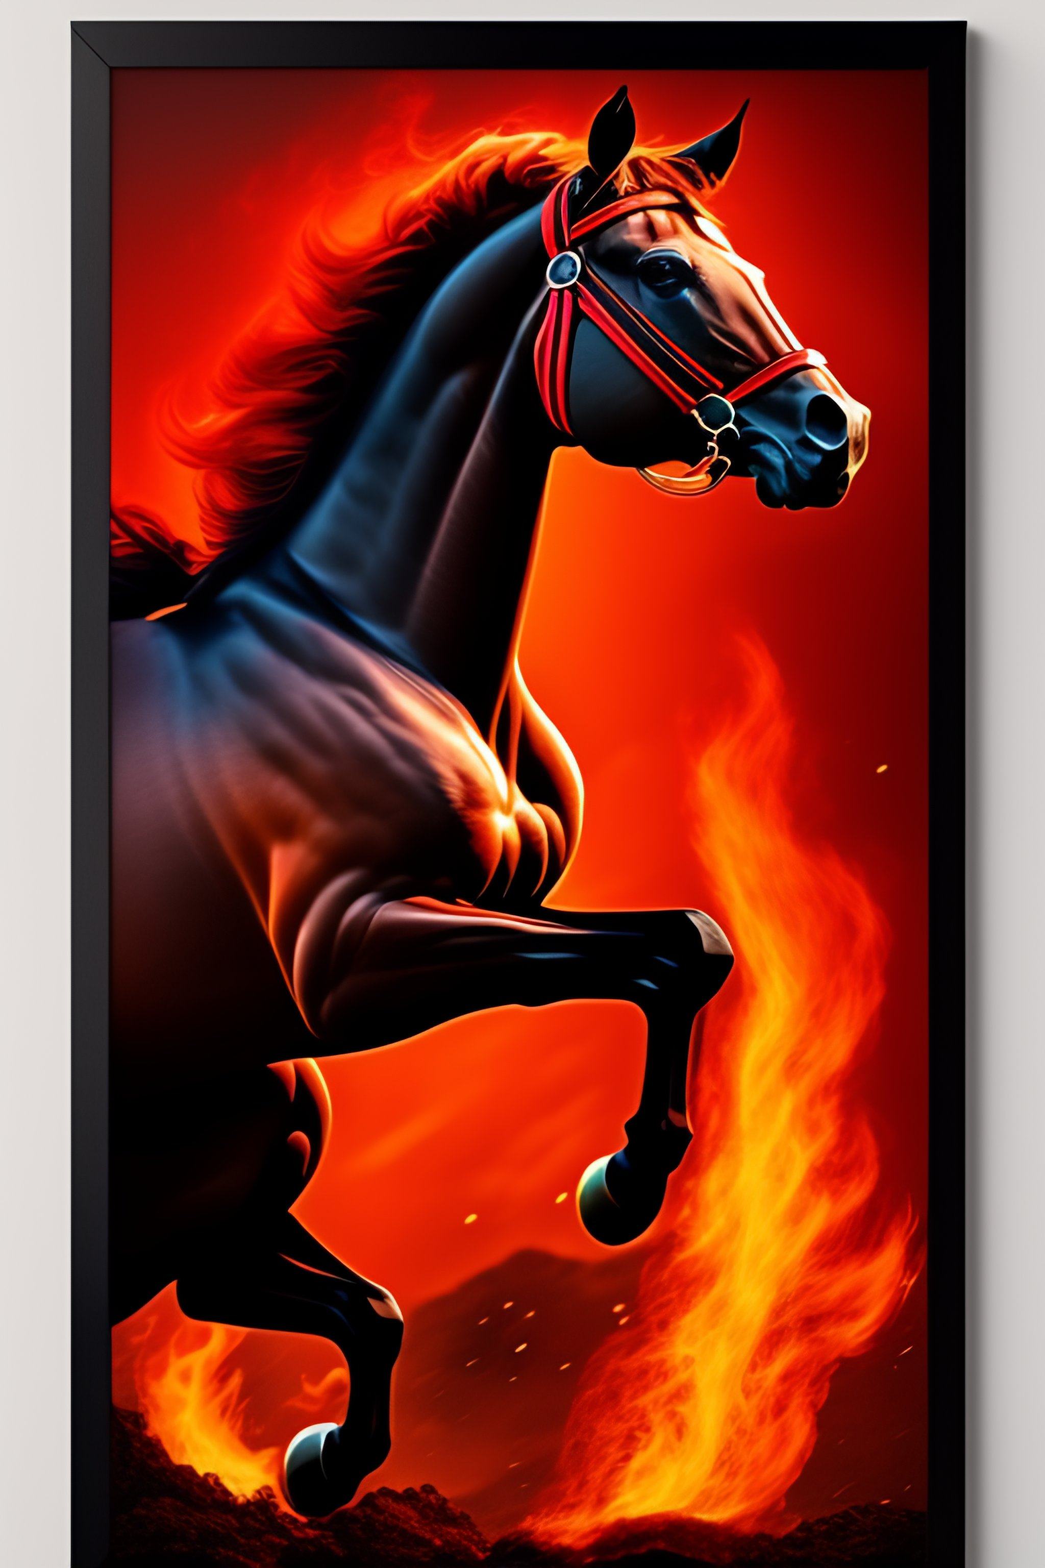

Slide 30




MATCHING

Slide 34

BANGLADESH UNIVERSITY OF ENGINEERING AND TECHNOLOGY
PROJECT ON IGRAPHICS
Level-1, Term-1
Project name : Word Matching Game
Project Submitted by :: Md. Shoyaib Rezwan
Student no. 2205014
Sec- A1, CSE-22
Date of Submission : 07/ 03/ 2024
Project Supervisor :: Rifat Rahman
Research Lecturer, Institute of Appropriate Technology (IAT),
BUET

Slide 35
SCORE BOARD
Player vs Computer
20 Cards (3 min)
20 Cards (5 min)
30 Cards (3 min)
30 Cards (5 min)
Clear Scoreboard

